Slide 1
Montgomery County Traffic Violations: An In-Depth Time Analysis
Notes:
Maybe for slides like no. 4 or 7 we can add images. Sure, do you want to look for some. I am working on the formatting rn. I added for 7, something like that? Like the design, its just not clear, it looks a bit blurry. Is there a more clear version/higher quality? Yep I’ll look for a better quality one
What do you think about this image for each slide? The small Montgomery County Logo in the top right corner? Yep we can do that, looks good

Slide 2






Meet the Team
Cheng Feng Lin
David Wu
Aradhya Singh Bisht
Emma Nehman
Akshay Sharma
Priyanka Gona
Notes:
I added a few images and a basic animation, have a look at that. Maybe ill change that once we download the pptx

Slide 3
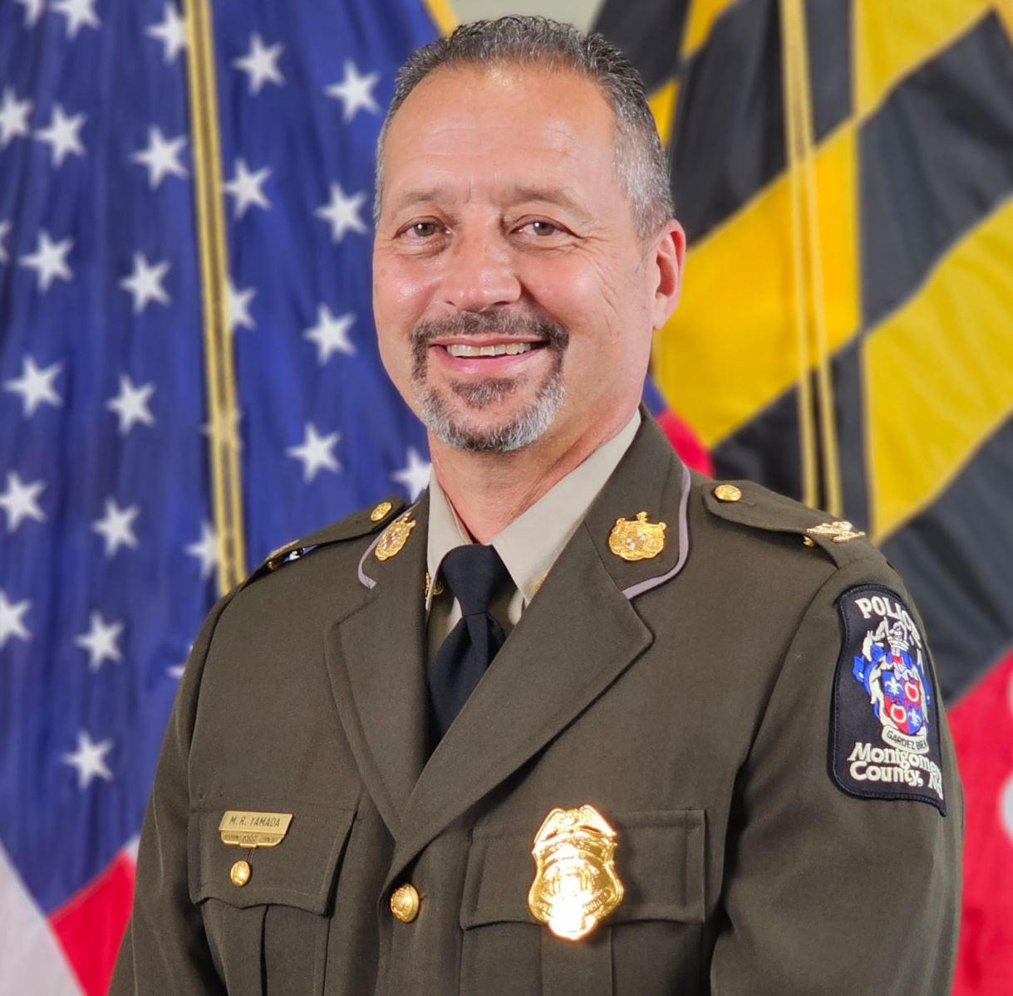
Background
Marc Yamada : Chief of Montgomery County Police Department
Wants to promote a stronger relationship between the community and the police force through trust and transparency
The Role of Data: Informed Decision Making and Resource Allocation
MCPD will be able to allocate resources more effectively
Time Based and Location Insights
Insights into hotspots during commute times
Notes:
By analyzing traffic violation data, the MCPD can allocate resources more effectively, address safety concerns, and demonstrate to the community that enforcement efforts are fair and strategic.
Imagine a local neighborhood with recurring traffic violations, especially during peak commute times. With data insights, Chief Yamada’s team can address these hotspots and deploy enforcement officers more strategically to improve safety without over-policing the area.

Slide 4

1. Data Cleaning & Organization
Notes:
Sorry LOL I was reorganizing . Yep I am actualling using that as background

Slide 5
About Our Data
Dataset Overview: Contains traffic violation data from 2018 to present
Key columns include:
Date Of Stop
Description
Latitude & Longitude
Personal Injury
Commercial Vehicle and License Type
Geographic Scope
Data spans only within Montgomery County, MD
Outcomes Tracked
Within each arrest, an ID is assigned to the stop
Demographics
Driver-related details such as race, gender, and city/state of residence
Added Montgomery County, MD diversity and population information

Slide 6
Cleaning Our Data
Data Import & Structure
Our loaded dataset contained 35 columns of traffic locations totaling over a million rows of data
Handlining Missing Values
Columns with >90% missing values: Dropped Entire Column
All other columns had <40 % missing values: Filled in with “Unknown
Date and Time Formatting
Converted “Date of Stop” into a DateTime format for easier time based filtering
Geolocation Data
Dropped the “Geolocation Columns”
Kept “Latitude” and “Longitude” columns, and removed rows where both values were (0.0,0.0)

Slide 7
Hypothesis
Do certain demographic groups experience higher traffic stop rates?
Hypothesis: The higher number of traffic stops for Black and Hispanic drivers is linked to areas where more people from these groups live, rather than just racial profiling or bias in police actions.

Slide 8
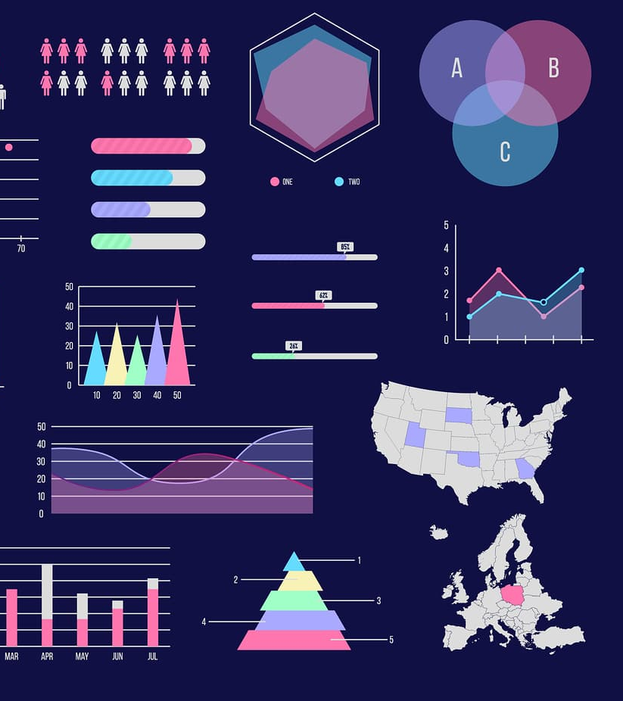
2. Data
Visualizations

Slide 9
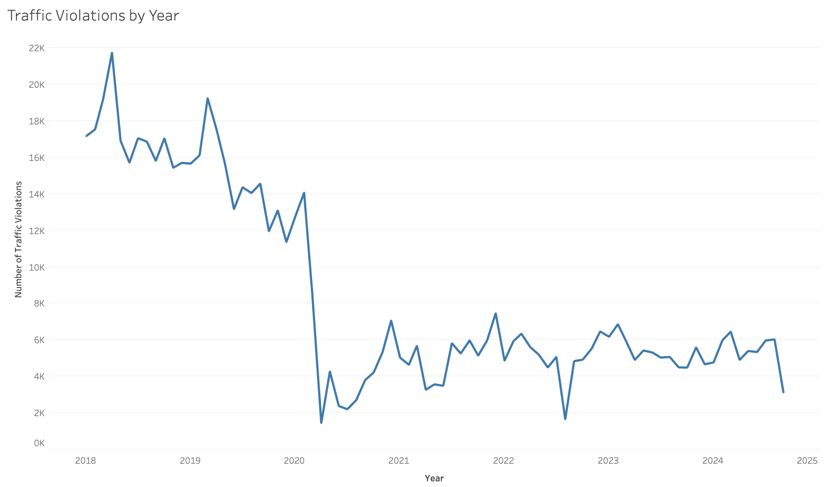
Traffic Violations Over Time
Key Takeaways:
Violations have decreased drastically over the past 7 years
Major decrease started in 2020, during/after COVID
Notes:
On the Rows, Count of ID (Filtered by Distinct)

Slide 10
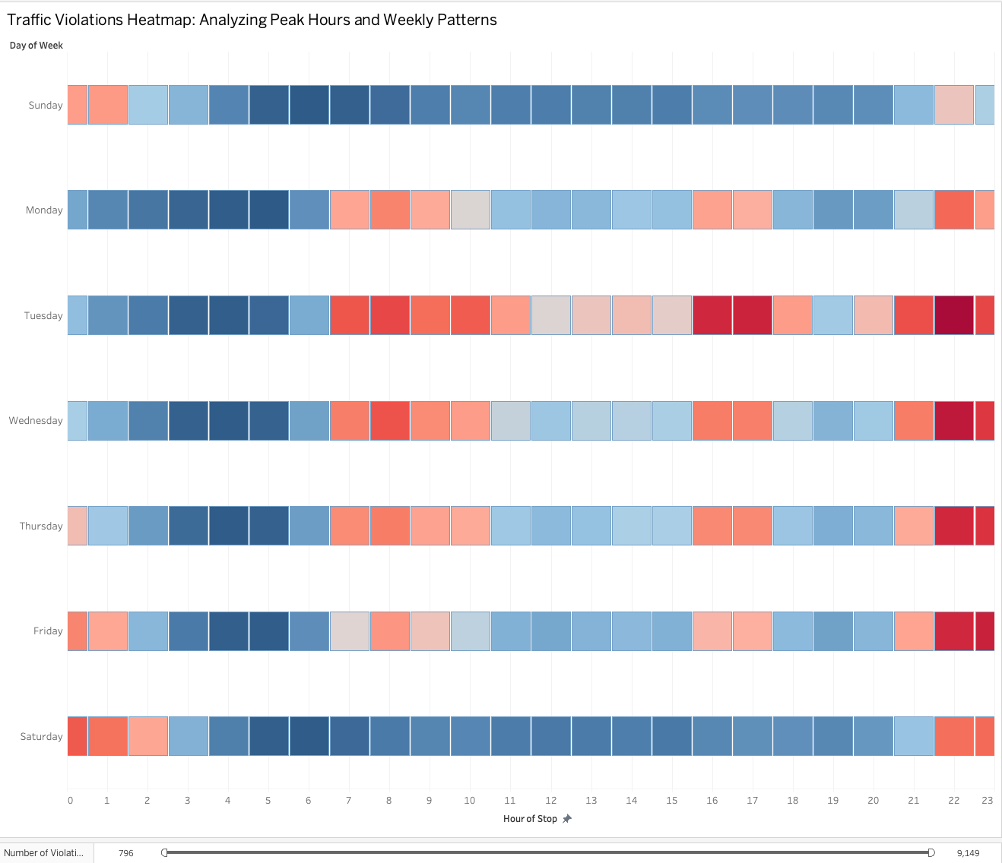
Analyzing Peak Hours and Weekly Patterns
Key Takeaways:
Peak Hours: 8-10 AM, 4-6 PM on weekdays.
Highest Violations: Tues-Thurs.
Busiest Day: Tuesday.
Weekends: Fewer violations.
Late Afternoons: 3-6 PM midweek/Friday.

Slide 11
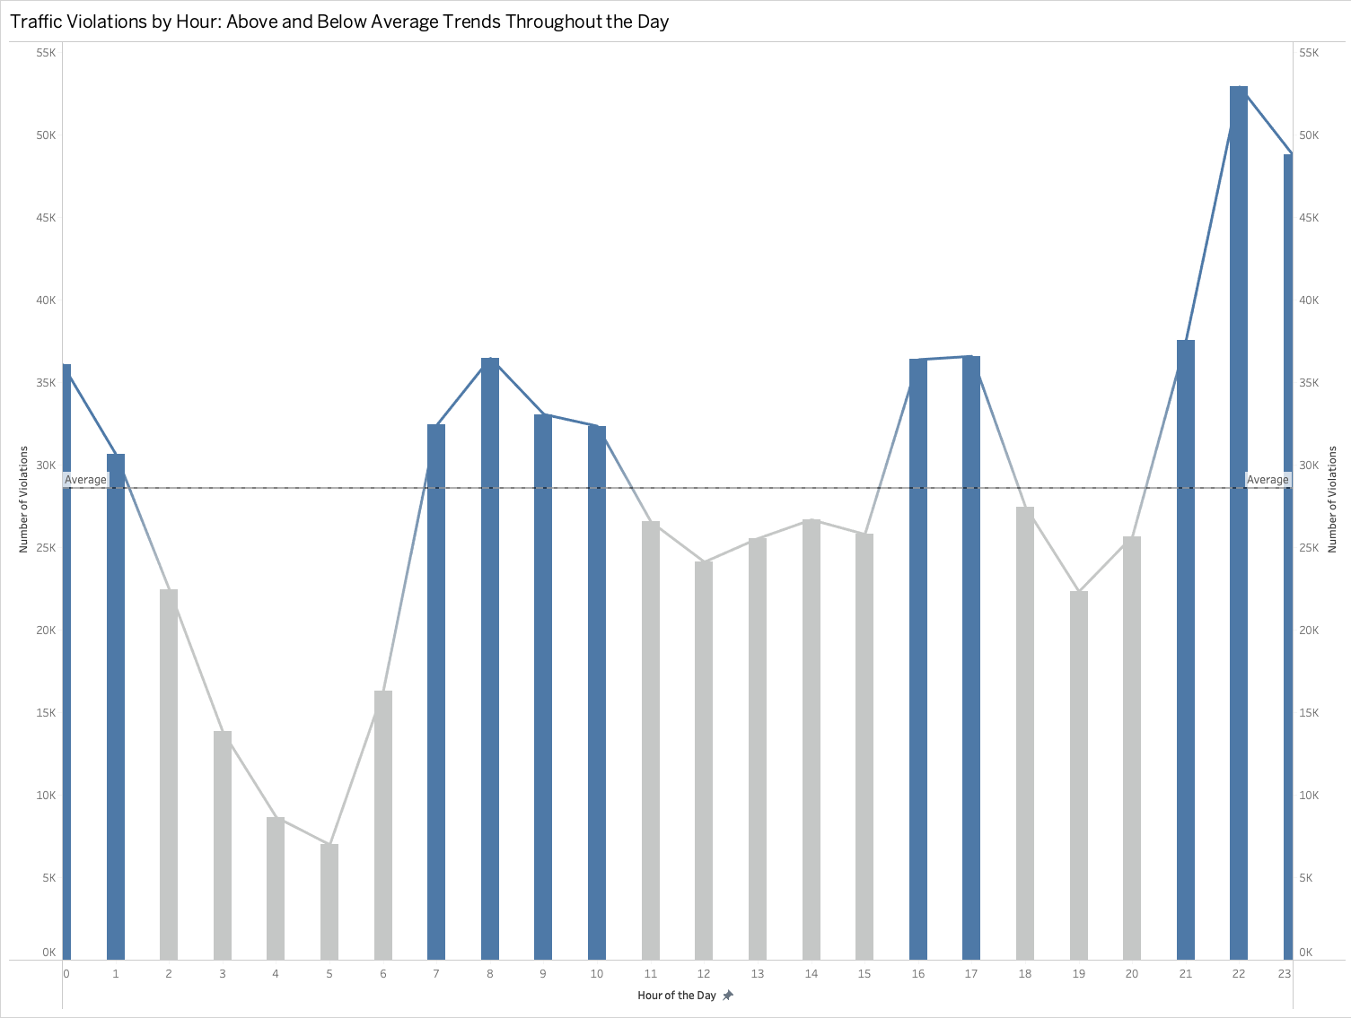
Time Based Traffic Violations
Key Takeaways:
Rush Hour Peaks: Major spikes at 7-9 AM and 5-8 PM.
Night Lull: Lowest violations from 2-5 AM.
Bi-Modal Pattern: Two distinct peaks related to work commutes.
Evening Surge: Unexpected rise in violations at 8-10 PM.
Post-Rush Activity: Violations remain high even after traditional rush hours, indicating extended evening activity.

Slide 12
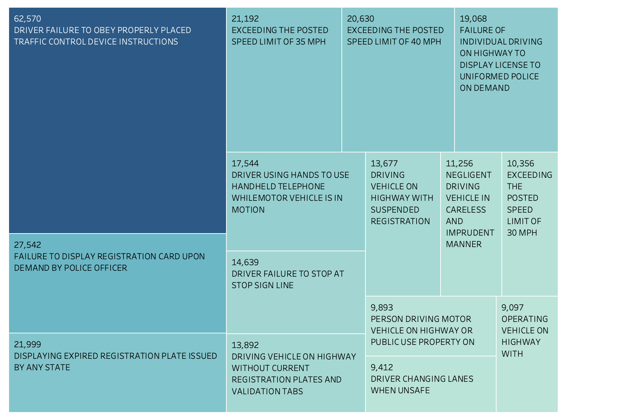
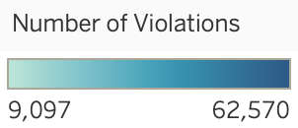
Top 15 Traffic Violations Types 2018-2024
Key Takeaways:
The majority of violations come from drivers failing to obey traffic instructions, failing to display registration or displaying expired registration, and exceeding speed limits
Notes:
We are now going to look deeper into traffic violations and outcomes, here we created a tree map that shows the top 15 traffic violation types from 2018-current. As you can see, the majority of violations come from drivers failing to obey traffic instructions, failing to display registration or displaying expired registration, and exceeding speed limits. Another common offense is using a hand held telephone

Slide 13
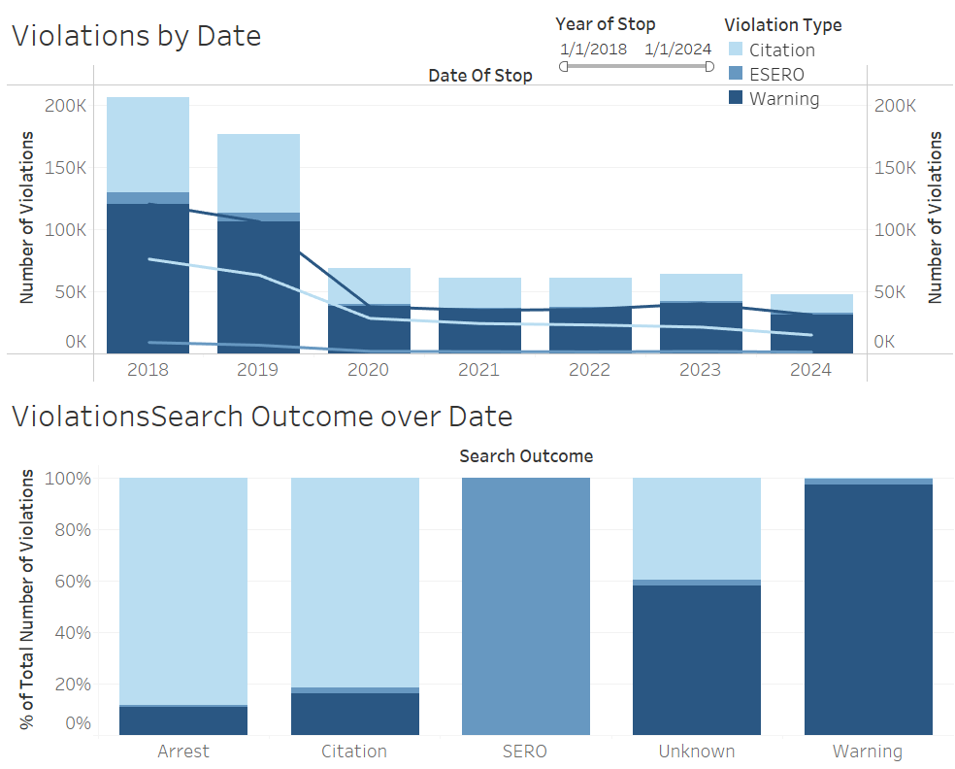
Violation Outcomes over time
Key Takeaways:
Overall violations show a dramatic decline from ~200K in 2018 to ~50K in 2024, representing a 75% reduction
Warnings (dark blue) consistently make up the largest portion of violations across all years
ESERO violations (light blue) have decreased more substantially than warnings over the period
The steepest decline occurred between 2018-2020, with stabilization from 2020 onwards
Warning-type violations have the highest search outcome rate at nearly 100%
Notes:
This area chart tracks violation patterns from 2018 to 2024, showing three types of violations: Citations, ESERO, and Warnings. There's a notable decline in overall violations from about 200,000 in 2018 to approximately 50,000 by 2020, after which the numbers stabilized. Warnings (shown in pink) consistently make up the largest portion of violations throughout the period. The most dramatic decrease occurred between 2019 and 2020, possibly coinciding with policy changes or external factors like the pandemic. This stacked bar chart shows the distribution of different violation outcomes across five categories: Arrest, Citation, SERO, Unknown, and Warning. Each bar represents the percentage breakdown for a specific violation type. Warnings dominate the "Warning" category at nearly 100%, while Arrests and Citations show a mix of primarily Citation outcomes. SERO violations are exclusively handled as SERO cases, showing strict categorization in enforcement procedures. Speaker Notes
Opening Context
These graphs track violation trends from 2018 to 2024
Data is categorized by violation types: Citations, ESERO, and Warnings
Analysis covers both total violations and search outcomes
Violation Volume Trends
Start by highlighting the dramatic overall decline from 2018
Emphasize the rapid decrease in the first two years
Point out the stabilization period post-2020
Note the consistent lower levels maintained through 2024
Violation Type Distribution
Highlight that Warnings remain the predominant violation type
Discuss the proportional decline in ESERO violations
Note the relatively smaller proportion of Citations throughout
Search Outcomes
Explain the varying success rates by violation type
Emphasize the near-perfect search outcome for Warnings
Compare the lower success rates for Arrests and Citations
Discuss implications for enforcement efficiency
Concluding Observations
Highlight the overall improvement in compliance over time
Discuss the effectiveness of warning-based enforcement
Note the sustained lower violation rates in recent years

Slide 14
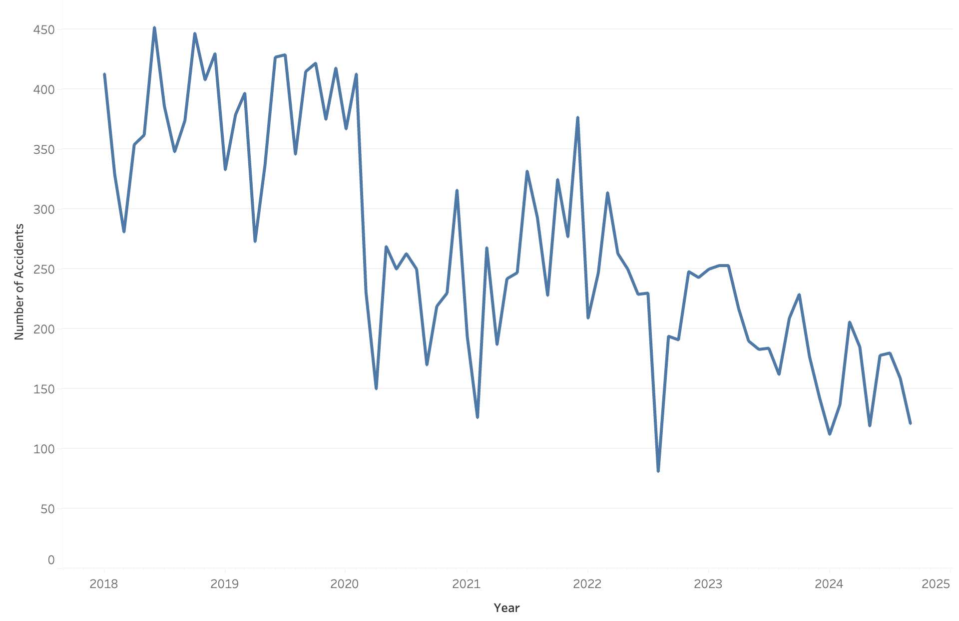
Traffic Violation Accidents Over Time
Key Takeaways:
The number of traffic violation accidents have decreased since 2018.
This may also be partially explained by COVID and less people being on the roads.

Slide 15

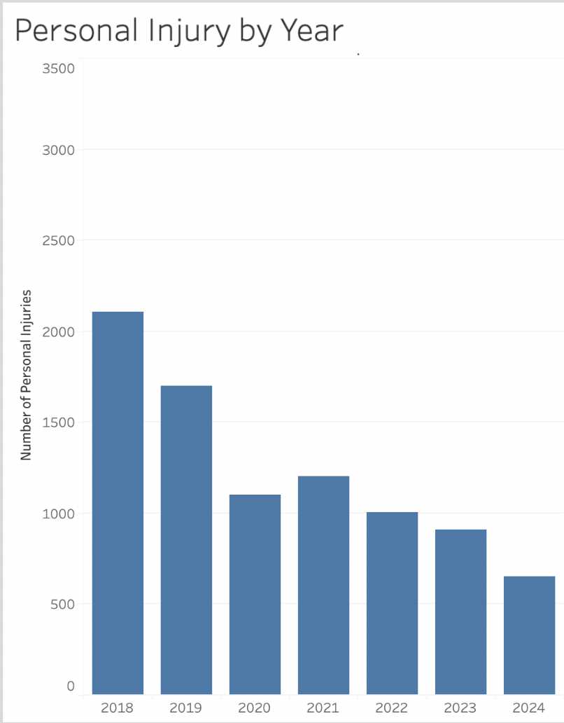
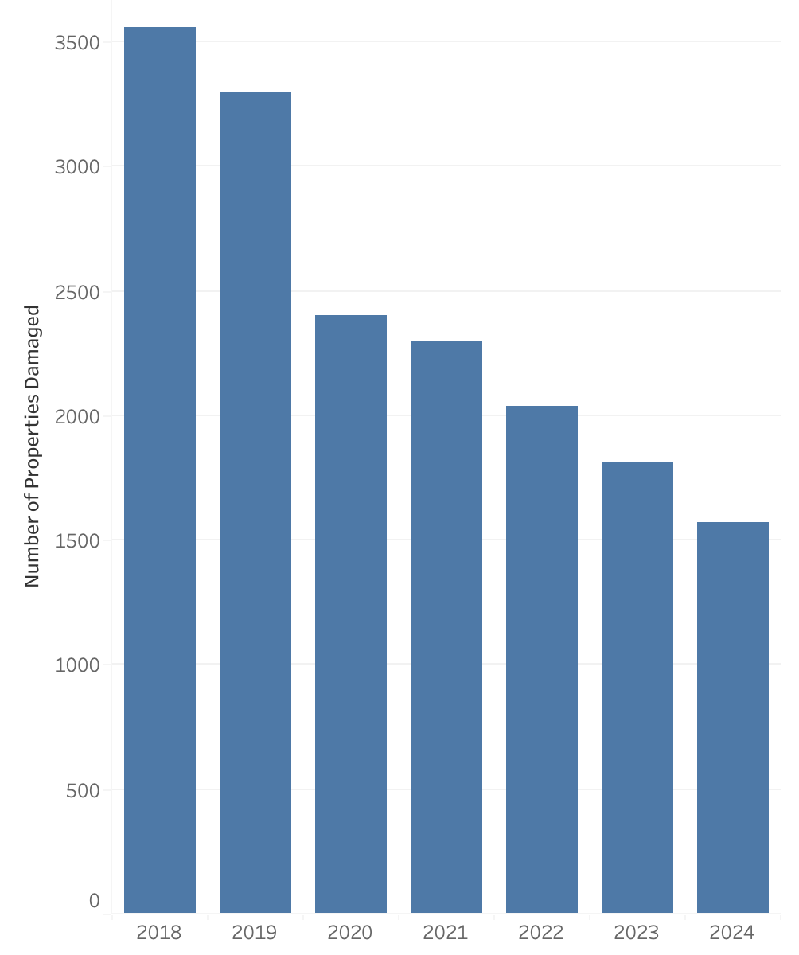
Property and Personal Damage Over Time
Key Takeaways:
Traffic violations cause property damage more often than personal injury
This may because the majority of traffic violations are minor and result in damage to the car rather than the driver or a passenger

Slide 16
Exploring the Human Impact of Traffic Stops
Beyond Accidents
While personal injury and property damage are key safety metrics, it is also important to understand who is being stopped and when to assess the broader impact of enforcement
Demographic Insights
Analyzing traffic stops by race and time of day helps uncover potential patterns or disparities which can give more insights to a safer community.
Notes:
As we dug deeper into the human impact of traffic stops, we examined two key factors: who is being stopped and when. While accidents are a primary concern, we also analyzed demographic data like race and time of day to identify potential patterns.

Slide 17
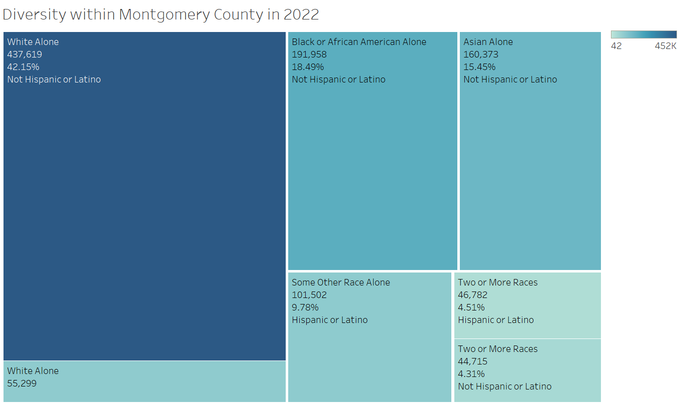
Largest Ethnic Groups in Montgomery County in 2022
Key Takeaways:
The top 3 largest ethnic groups in Montgomery County are White (Non-Hispanic), Black/Native American (Non-Hispanic), and Asian (Non-Hispanic).
There is a 20% Hispanic Population
Notes:
Montgomery County is a racially and ethnically diverse community with a significant presence of White, Black or African American, Asian, and Hispanic or Latino populations.
In 2022, the number of White (non-Hispanic) residents in Montgomery County were twice that of any other race or ethnicity. The three largest ethnic groups in the county are White, Black/Native American, and Asian. Notably, the Hispanic population comprises approximately 211K individuals, accounting for around 20% of the total population in Montgomery County.

Slide 18
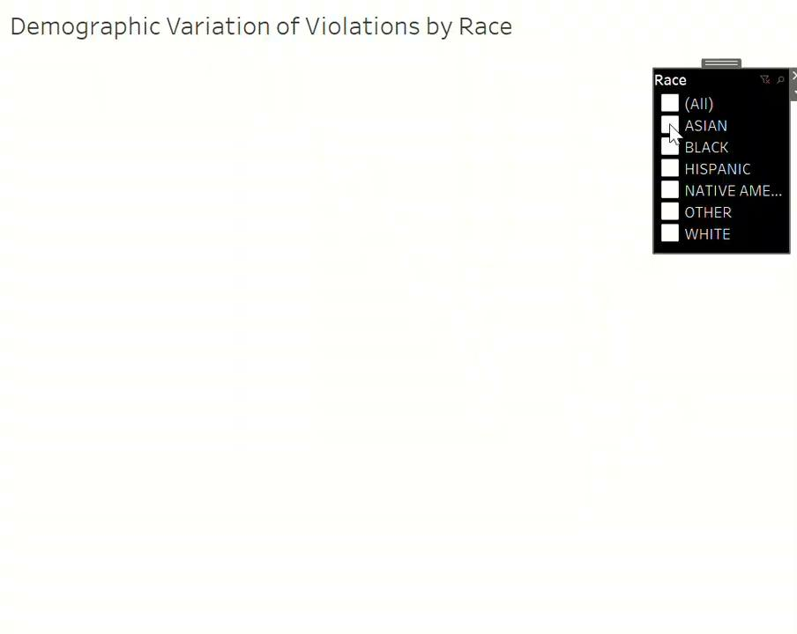
Demographic Violations
Key Takeaways:
Black and Hispanic populations show significant clustering of violations in central regions, while other group like Native American populations have violations that are more scattered or concentrated in specific, smaller areas.
The White population appears to have violations spread out over a broader area, with some major clusters in suburban regions.
Notes:
As we proceed to analyze the demographic variations in violations by race, we observe that violations among the Asian, Black, and Hispanic groups tend to be more clustered. You can see how each racial group’s violations are mapped out as the video is playing.
In contrast, violations within the White population are more broadly distributed. Additionally, the Native American group exhibits significantly fewer violations compared to the other groups.

Slide 19
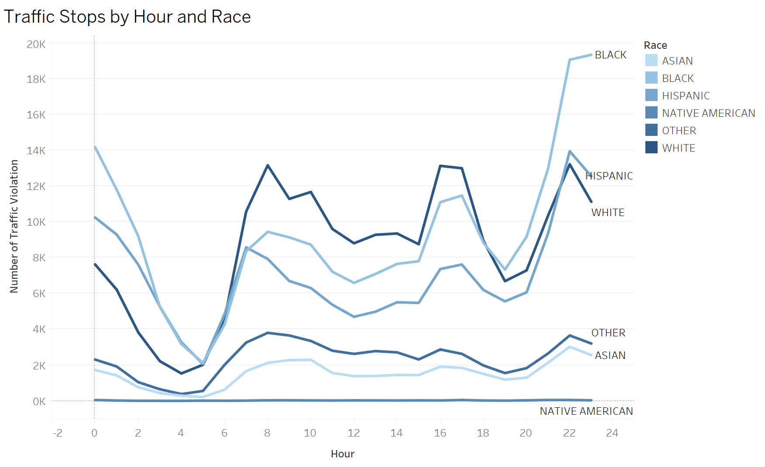
Hourly Traffic Stops by Race
Key Takeaways:
Traffic stops peak in the late evening, with Black and Hispanic drivers experiencing the highest numbers, while Asian and Native American drivers show consistently lower stop rates throughout the day
Notes:
Sequential Palette: Red to Blue. Explain what “Other” is. Does it mean mixed? Speaker Notes (Key Points):
"The hourly distribution of traffic stops reveals significant variations across racial groups, with notable disparities during certain time periods."
"When we overlay violation types with stop times, we see patterns that suggest both enforcement priorities and community behavior patterns."
"The demographic composition of Montgomery County provides crucial context for understanding these patterns, particularly the disparity between population percentages and stop rates."
"Peak violation times correlate with specific violation types, suggesting opportunities for targeted interventions that consider both time and community factors."
"The combined analysis reveals complex interactions between demographics, time of day, and violation types, pointing to opportunities for more equitable and effective traffic safety measures."

Slide 20
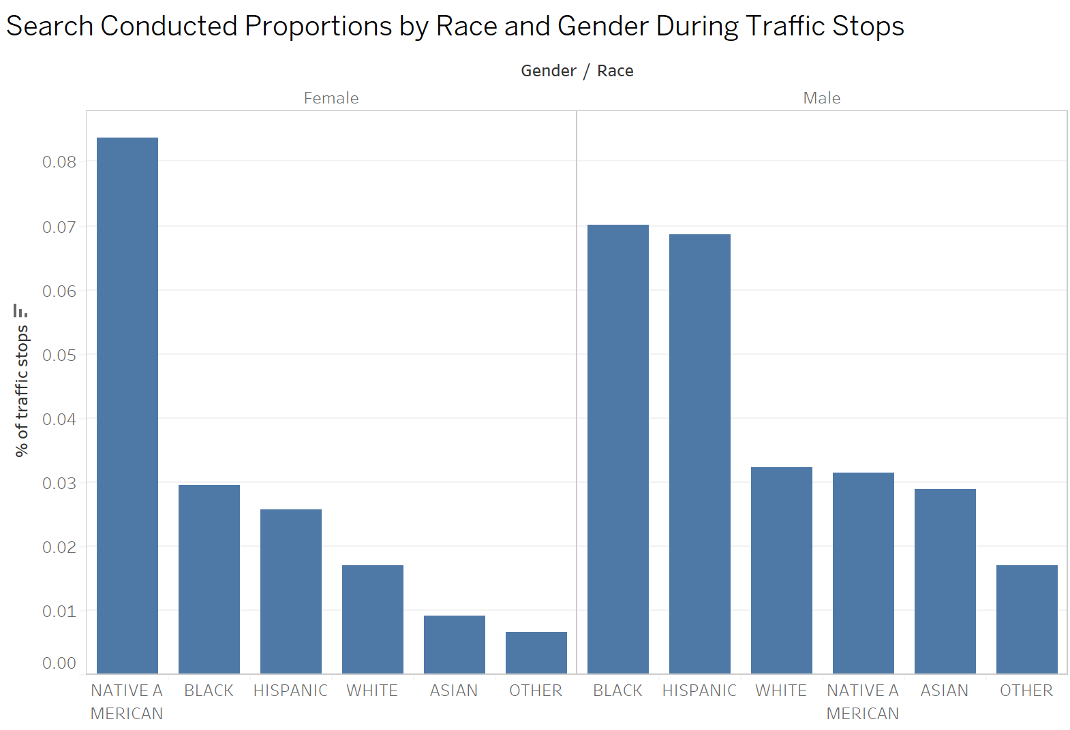
Search Conducted Rates by Race and Gender
Key Takeaways:
Search rates are generally low, with female Native American drivers searched most frequently, followed by male Black drivers and male Hispanic drivers

Slide 21

3. Findings & Conclusions
Notes:
Decline in Traffic Violations: Violations dropped 75% from 2018 to 2020, stabilizing at lower levels post-COVID, indicating effective policies and behavior shifts.
Disparities by Race: Black and Hispanic drivers face higher stop rates, especially in the evening, while Native American women experience disproportionately high search rates. Asian and Native American drivers have consistently lower stop rates.
Consistent Enforcement: SERO cases and warnings are handled uniformly across all groups, but search rates suggest biases in enforcement, especially by race and gender.
Diverse Population: The county’s diverse demographics (20% Hispanic, significant Black and Asian populations) highlight the need for equitable enforcement practices that consider racial disparities.
COVID-19 Impact: Pandemic reduced violations and accidents, but lower rates have persisted, suggesting long-term changes in road behavior.

Slide 22
Findings/Conclusions
Traffic Violations Decrease: 75% drop from 2018 to 2020, likely due to COVID-19.
Post-2020 Stabilization: Violations stabilize at a lower level; some fluctuations, no major increases.
Peak Times: Higher violations during midday and afternoon, especially on Tuesdays and Fridays.
Low Violation Times: Fewer violations in mornings and late nights.
Rush Hour Peaks: Increased violations observed from 7 AM-9 AM and 5 PM-7 PM.
Violation Types: Common violations include failing to obey traffic instructions, expired registration, and speeding.
Notes:
Introduction: Highlight the significant decrease in traffic violations during the pandemic, linking it to reduced vehicle activity.
2020 Onward: Mention how the trend has stabilized post-pandemic but note the fluctuations that still occur.
Time Patterns: Emphasize the trends in violation occurrences, noting the specific days and times where violations peak.
Rush Hours: Discuss the implications of increased traffic during rush hours and how it correlates with violation rates.
Violation Details: Elaborate on the types of violations that are most common, indicating areas for potential law enforcement focus or public awareness campaigns.
Conclusion: Reinforce the importance of understanding these patterns for future traffic management strategies.

Slide 23
Findings/Conclusions
Traffic Stops Peak: Highest in the late evening.
Driver Demographics: Black and Hispanic drivers have the highest stop rates and higher relative rates compared to their population proportion.
Lower Rates: Asian and Native American drivers show consistently lower stop rates throughout the day.
Human Impact: Black and Hispanic drivers experience notably higher stop rates, especially at night.
Search Rates: Generally low; however, specific demographics are searched more frequently:
Female Native American drivers
Male Black drivers
Male Hispanic drivers
Notes:
Introduction: Introduce the topic of traffic stops, highlighting the time of day when they peak.
Demographic Insights: Discuss the disparities in stop rates among different racial and ethnic groups, focusing on Black and Hispanic drivers.
Time of Day: Emphasize the significant increase in traffic stops during the late evening and the implications this may have for communities.
Search Rates: Explain the low overall search rates, but point out the specific groups that experience higher search frequencies, noting the potential reasons and concerns.
Conclusion: Stress the need for awareness and discussion around these disparities to inform policy and community engagement strategies.

Slide 24

4. Questions?

